Slide 1


Fundamentals of Web and UX Design
School of Computer Science and Engineering

Slide 2
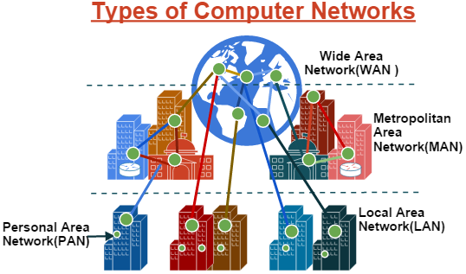
Unit 1 Web and HTML Fundamentals
Network: A network consists of two or more computers that are linked in order to share resources (such as printers and CDs), exchange files, or allow electronic communications. The computers on a network may be linked through cables, telephone lines, radio waves, satellites, or infrared light beams.
Notes:
https://en.wikipedia.org/wiki/Internet
Types of network with distance covered in km’s special mention about PAN and VPN

Slide 3
Unit 1 Web and HTML Fundamentals
Internet: The Internet is at once a worldwide broadcasting capability, a mechanism for information dissemination, and a medium for collaboration and interaction between individuals and their computers without regard for geographic location.
The Internet is the global system of interconnected computer networks that uses the Internet protocol suite (TCP/IP) to communicate between networks and devices.
The Internet carries a vast range of information resources and services, such as the interlinked hypertext documents and applications of the World Wide Web (WWW), electronic mail, telephony, and file sharing.

Slide 4
Unit 1 Web and HTML Fundamentals
Origin of the Internet
Early Networking Concepts (1960s1970s):
ARPANET: The precursor to the Internet, ARPANET was developed in the late 1960s by the U.S. Department of Defense’s Advanced Research Projects Agency (ARPA).
TCP/IP Protocols: In the 1970s, Vint Cerf and Bob Kahn developed the Transmission Control Protocol (TCP) / User Datagram Protocol(UDP) and Internet Protocol (IP). These protocols became the foundation for data transmission on the Internet.
Expansion and Standardization (1980s):
Birth of the Internet: In 1983, ARPANET adopted TCP/IP, and the modern Internet was born. This protocol suite allowed different networks to interconnect and communicate, forming a network of networks.
Domain Name System (DNS): Introduced in 1984, the DNS allowed users to access websites using humanreadable addresses instead of numerical IP addresses.
Notes:
https://en.wikipedia.org/wiki/Internet
https://en.wikipedia.org/wiki/Hypertext
https://www.internetsociety.org/internet/historyinternet/briefhistoryinternet/

Slide 5
Unit 1 Web and HTML Fundamentals
Public Access and Growth (1990s):
World Wide Web: In 1991, Tim Berners Lee introduced the World Wide Web (WWW), a system for publishing and accessing documents over the Internet using hypertext. This made the Internet more accessible to the public.
Web Browsers and HTML: Early web browsers, like Mosaic (1993) and Netscape Navigator (1994), made it easier to navigate the web. HTML (Hypertext Markup Language) became the standard for creating web pages.
Modern Internet and UX Development (2000s - Present):
Web 2.0: The early 2000s saw the rise of Web 2.0, characterized by interactive and user generated content. This shift emphasized User Experience (UX) design, focusing on making web applications more user friendly and interactive.
Responsive Design: With the increasing variety of devices, responsive web design became crucial to ensure websites function well across desktops, tablets, and smartphones.
Notes:
https://en.wikipedia.org/wiki/Internet
https://en.wikipedia.org/wiki/Hypertext
https://www.internetsociety.org/internet/historyinternet/briefhistoryinternet/

Slide 6
Unit 1 Web and HTML Fundamentals
What is the Web?
Web (a.k.a. World Wide Web(WWW)) is a vast network of interconnected documents and resources accessed via the Internet. It enables users to view and interact with content using web browsers. The Web is distinct from the Internet, which is the underlying infrastructure of interconnected networks that supports various services, including the Web.
The Web (short for World Wide Web) is a Hypertext based global information system that was originally developed at the European Laboratory for Particle Physics in Geneva, where all documents and resources are formatted using Hypertext Markup Language (HTML).
HTML and HTTP, makes it easy to find and view data and documents stored on computers connected to the Internet. HTML creates the links (“hyperlinks”) that enable the user to move among many Web documents with the click of a mouse.
Notes:
https://en.wikipedia.org/wiki/Internet
https://en.wikipedia.org/wiki/Hypertext
https://www.internetsociety.org/internet/historyinternet/briefhistoryinternet/
Relevance to Web and UX Development
Understanding the origins of the Internet provides context for the principles of web and UX development:
Protocol Evolution: Knowledge of protocols like TCP/IP helps in understanding how data is transmitted and how to optimize web performance.
Web Standards: Familiarity with HTML and CSS evolution aids in creating wellstructured and visually appealing websites.
User Experience Focus: The development of Web 2.0 and responsive design principles emphasizes the importance of creating intuitive, accessible, and engaging user experiences.
https://backend.turing.edu/module2/lessons/how_the_web_works_http
https://www.gartner.com/en/informationtechnology/glossary/web#:~:text=The%20Web%20(short%20for%20World,for%20Particle%20Physics%20in%20Geneva.

Slide 7
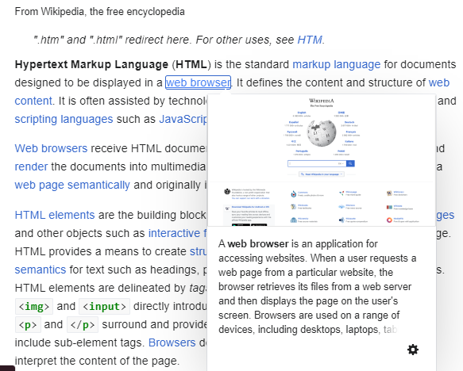

Slide 8
Unit 1 Web and HTML Fundamentals
HTML or Hypertext Markup Language: is a markup language for the web that defines the structure of web pages.
Hypertext: text (often with embeds such as images, too) that is organized in order to connect related items
Markup: a style guide for typesetting anything to be printed in hardcopy or soft copy format
Language: a language that a computer system understands and uses to interpret commands.
HTML determines the structure of web pages. This structure alone is not enough to make a web page look good and interactive. So you'll use assisted technologies such as CSS and JavaScript to make your HTML beautiful and add interactivity, respectively.
Notes:
https://www.freecodecamp.org/news/whatishtmldefinitionandmeaning/

Slide 9
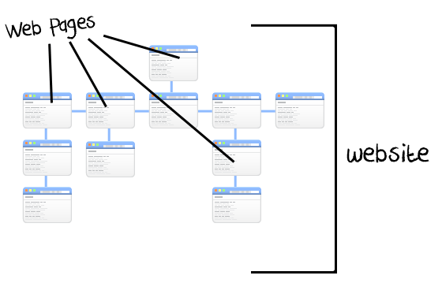
Unit 1 Web and HTML Fundamentals
Key Components of the Web:
Web Pages: Individual documents written in HTML (Hypertext Markup Language) that are displayed in web browsers. These pages can include text, images, videos, and links to other pages.
Web Sites: Collections of related web pages hosted on a single domain. For example, a company's website may contain multiple pages like Home, About Us, Services, and Contact.

Slide 10
Unit 1 Web and HTML Fundamentals
Web Browsers: Software applications like Google Chrome, Mozilla Firefox, Safari, and Microsoft Edge that interpret and display web pages. Browsers translate HTML, CSS, and JavaScript into the interactive content users see.
Search Engine: (like Google, bing etc.) is a tool that helps you find websites you're looking for using keywords or key phrases.
Web Servers: Computers that store web pages and serve them to users over the Internet. When a browser requests a page, the web server sends the necessary files to the browser.
URLs (Uniform Resource Locators): Addresses used to access web pages. For example, https://www.example.com is a URL that directs a browser to a specific web site.
Notes:
https://www.internetadvisor.com/thestoryofthewebahistoryofinternetbrowsers

Slide 11
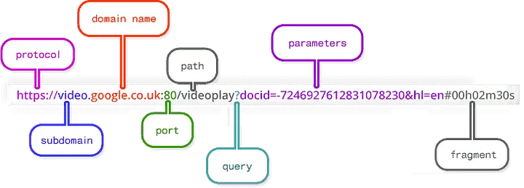
Unit 1 Web and HTML Fundamentals
URL Structure
Scheme: The protocol, also known as the scheme, is the first part of a URL. It represents the sets of rules that decide how files are displayed, formatted, or transferred across the web. For example, when an address is entered in the browser, the http part , which stands for hypertext transfer protocol, tells it that the page is to be displayed in hypertext format (HTML)
Notes:
https://medium.com/@joseph.pyram/9partsofaurlthatyoushouldknow89fea8e11713
https://en.wikipedia.org/wiki/URL?source=post_page89fea8e11713#Syntax

Slide 12
Unit 1 Web and HTML Fundamentals
Domain name: is the actual name of the website. ‘google’ in ‘google.com’. Domain names must be unique as they literally determine the address of a website. In the early days of the web, you actually had to type the IP address to go to a particular site. Later on, words were used instead as they were easier to remember.
Top Level Domain (TLD): is also known as the domain extension. It is the ‘com’ that appears at the end of simple websites addresses. This part specifies what kind of content will be on the website. ‘.com’ was primarily used for commercial sites, ‘.org’ is usually used to indicate that the website is that of an organization, When it comes to buying a domain, the domain extension can decide how expensive it is. Example: .edu.in
Port: is a reserved channel used for specific purposes. Different types of servers will use different ports. Web server ports differ from file server ports, for instance.

Slide 13
Unit 1 Web and HTML Fundamentals
Path: used to show which directory on server stores the resources (files, videos, audio, etc.) that are being requested. Nowadays, the path that appears in most URLs these days don’t forcibly reflect the directory structure on the server. Instead, paths are used to identify a route in the navigational structure of the website.
Query: Many times when searching on a website or search engine, you’ll see a question mark in the URL of the page that display your results. On google.com, if you search for keyword, you’ll see a ‘/search?’ added after the ‘.com’. The question mark tell the browser that a query is being performed against a database where the data is stored.
Parameters: are the actual values being queried when a search is performed. The parameter can be search term, a number, an encrypted value or any other data that can be found on the database. Copy and paste the following address to your browser’s address bar to see shoes: https://www.amazon.com/s?k=shoes

Slide 14
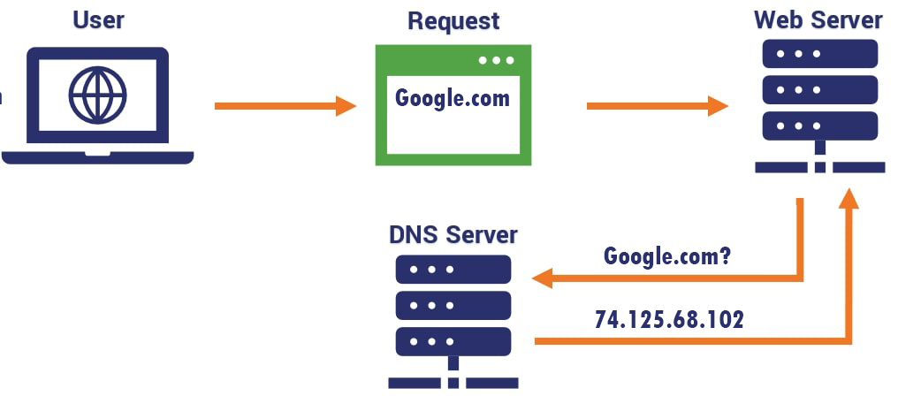
Unit 1 Web and HTML Fundamentals
Domain Name Service
Notes:
https://en.wikipedia.org/wiki/Internet
https://www.fortinet.com/resources/cyberglossary/whatisdns#:~:text=What%20is%20DNS%3F,use%20to%20locate%20the%20device.
https://en.wikipedia.org/wiki/Hypertext
https://www.internetsociety.org/internet/historyinternet/briefhistoryinternet/
https://www.fortinet.com/resources/cyberglossary/whatisdns#:~:text=What%20is%20DNS%3F,use%20to%20locate%20the%20device.
Relevance to Web and UX Development
Understanding the origins of the Internet provides context for the principles of web and UX development:
Protocol Evolution: Knowledge of protocols like TCP/IP helps in understanding how data is transmitted and how to optimize web performance.
Web Standards: Familiarity with HTML and CSS evolution aids in creating wellstructured and visually appealing websites.
User Experience Focus: The development of Web 2.0 and responsive design principles emphasizes the importance of creating intuitive, accessible, and engaging user experiences.

Slide 15
Unit 1 Web and HTML Fundamentals
Hypertext Transfer Protocol (HTTP)
All Web communications transactions use the protocol: the Hypertext Transfer Protocol (HTTP).
Latest version is HTTP 3 published in 2022
HTTP complete cycle consists of two phases: the request and the response.
Each HTTP communication (request or response) between a browser and a Web server consists of two parts: a header and a body.
The header contains information about the communication; the body contains the data of the communication if there is any.
Notes:
https://en.wikipedia.org/wiki/Internet
https://en.wikipedia.org/wiki/Hypertext
https://www.internetsociety.org/internet/historyinternet/briefhistoryinternet/
Relevance to Web and UX Development
Understanding the origins of the Internet provides context for the principles of web and UX development:
Protocol Evolution: Knowledge of protocols like TCP/IP helps in understanding how data is transmitted and how to optimize web performance.
Web Standards: Familiarity with HTML and CSS evolution aids in creating wellstructured and visually appealing websites.
User Experience Focus: The development of Web 2.0 and responsive design principles emphasizes the importance of creating intuitive, accessible, and engaging user experiences.

Slide 16
Unit 1 Web and HTML Fundamentals
How the Web Works:
Request and Response Cycle: When you enter a URL in your browser, it sends a request to the web server hosting the site. The server processes this request and sends back the appropriate web page and resources (like images and stylesheets).
HTTP complete cycle consists of two phases: the request and the response.
Each HTTP communication (request or response) between a browser and a Web server consists of two parts: a header and a body.
The header contains information about the communication;
The body contains the data of the communication if there is any.
Notes:
https://en.wikipedia.org/wiki/Internet
https://en.wikipedia.org/wiki/Hypertext
https://www.internetsociety.org/internet/historyinternet/briefhistoryinternet/
Relevance to Web and UX Development
Understanding the origins of the Internet provides context for the principles of web and UX development:
Protocol Evolution: Knowledge of protocols like TCP/IP helps in understanding how data is transmitted and how to optimize web performance.
Web Standards: Familiarity with HTML and CSS evolution aids in creating wellstructured and visually appealing websites.
User Experience Focus: The development of Web 2.0 and responsive design principles emphasizes the importance of creating intuitive, accessible, and engaging user experiences.

Slide 17
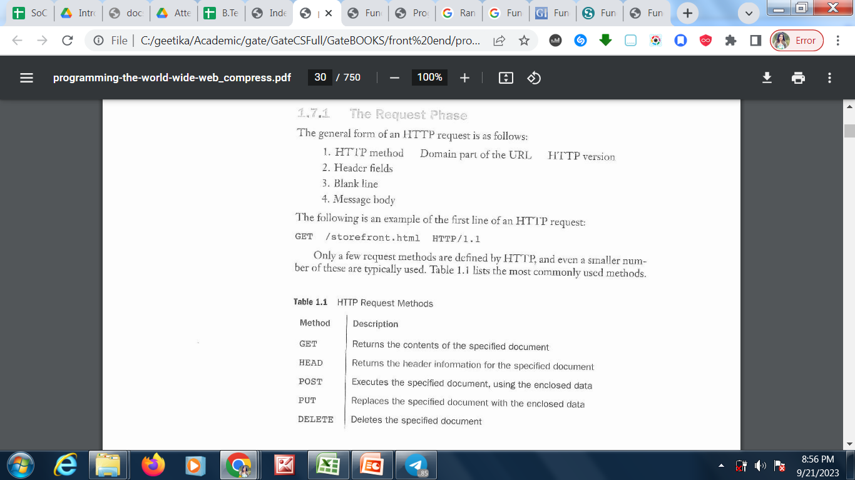
Unit 1 Web and HTML Fundamentals
HTTP Request:
Think about an HTTP request as your browser connecting to the server and either asking for a specific resource or sending data to it. There are several types of HTTP request methods, which completely alter the type of response that you get from the server.

Slide 18
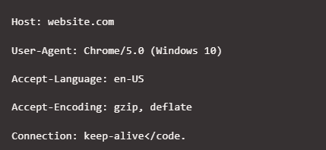
Unit 1 Web and HTML Fundamentals
Request Headers:
Request headers come right after request lines and they provide additional information on the transaction. The header specifies information about the host, the web server software the end-client uses, what the client’s user agent is, and more.

Slide 19
Unit 1 Web and HTML Fundamentals
Header Parameters:
Host: This is the IP or URL of the server that you’re making the request to.
User-agent: This parameter contains information about the client and its Operating System (OS). Typically, this outlines the browser that you’re using and its version.
Accept-language: This line tells the server what language the client prefers, in case there are multiple versions of the file that you’re requesting.
Accept-encoding: This line indicates the type of encoding or compression that the client can process.
Connection: This parameter tells the server whether to keep the connection alive or set a timeout for it. If the connection times out before completing the request, you’ll receive an error.

Slide 20
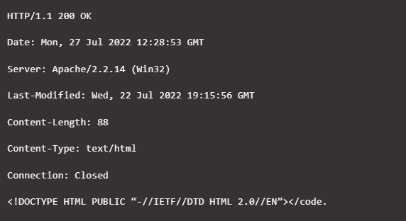
Unit 1 Web and HTML Fundamentals
HTTP Message Body
The message body is the most straightforward part of an HTTP request. This contains the data that you’re either sending or receiving, depending on what request method you’re using.
Notes:
https://kinsta.com/knowledgebase/what-is-an-http-request/

Slide 21
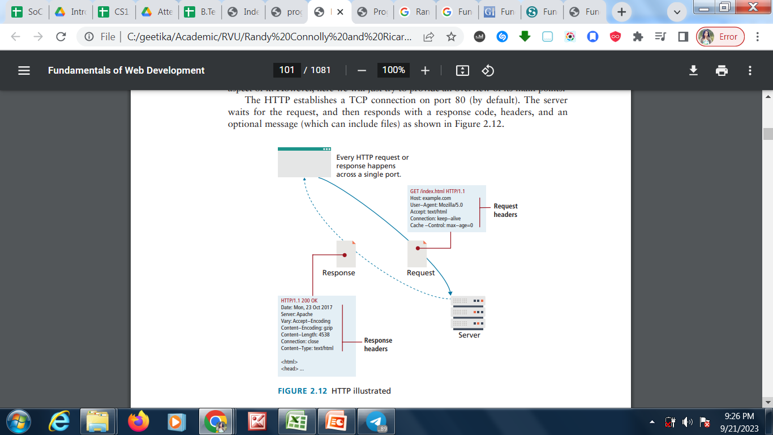
Unit 1 Web and HTML Fundamentals

Slide 22
Unit 1 Web and HTML Fundamentals
HTTP Request:
An HTTP request is your browser connecting to the server and either asking for a specific resource or sending data to it. There are several types of HTTP request methods, which completely alter the type of response that you get from the server. The most common ones are:
GET: This is the most frequently used HTTP request method by far. A GET request asks the server for a specific piece of information or resource. When you connect to a website, your browser usually sends several GET requests to receive the data that it needs for the page to load.
HEAD: With a HEAD request, you only receive the header information of the page that you want to load. You can use this type of HTTP request to find out the size of a document before you download it using GET.
POST: Your browser uses the POST HTTP request method when it needs to send data to the server. For example, if you fill out a contact form on a website and submit it, you’re using a POST request so the server receives that information.
PUT: PUT requests are similar in functionality to the POST method. However, instead of submitting data, you use PUT requests to update information that already exists on the end server.

Slide 23
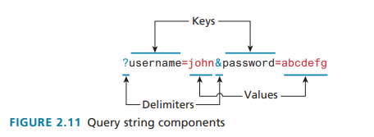
Unit 1 Web and HTML Fundamentals
GET request method:
In this request, one is asking for a resource located at a specified URL to be retrieved.
Whenever you click on a link, type in a URL in your browser, or click on a bookmark, you are usually making a GET request.
Data can also be transmitted through GET request – through the URL as query string

Slide 24
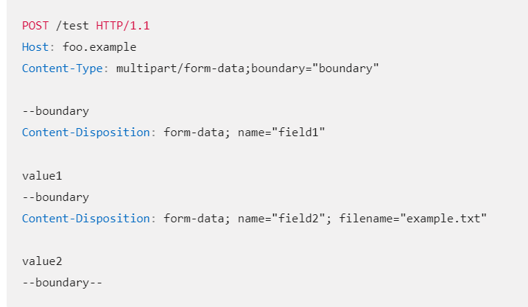
Unit 1 Web and HTML Fundamentals
POST request method:
This method is normally used to transmit data to the server using an HTML form.
Used when the user wants to change the data/content at server.
No limitation on data length ; GET has limitation
While making changes to data – use POST not GET ; due to security issues
Example : Adding a new user through a signup modal, Posting a message to a bulletin board, newsgroup, mailing list, or similar group of articles.

Slide 25
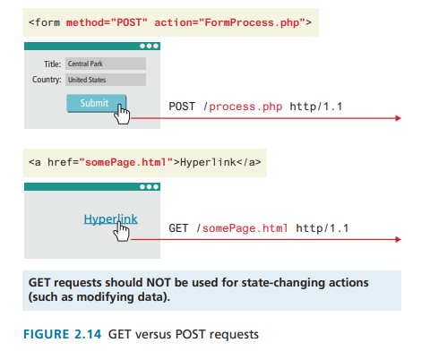
Unit 1 Web and HTML Fundamentals
PUT is best used when you are updating or replacing existing data on the server; POST is only to create/add new data.

Slide 26
Unit 1 Web and HTML Fundamentals
HTTP GET | HTTP POST
In GET method we can not send large amount of data rather limited data of some number of characters is sent because the request parameter is appended into the URL. | In POST method large amount of data can be sent because the request parameter is appended into the body.
GET request is comparatively better than Post so it is used more than the Post request. | POST request is comparatively less better than Get method, so it is used less than the Get request.
GET requests are only used to request data (not modify) | POST requests can be used to create and modify data.
GET request is comparatively less secure because the data is exposed in the URL bar. | POST request is comparatively more secure because the data is not exposed in the URL bar.
Request made through GET method are stored in Browser history. | Request made through POST method is not stored in Browser history.
GET method request can be saved as bookmark in browser. | POST method request can not be saved as bookmark in browser.

Slide 27
Unit 1 Web and HTML Fundamentals
HTTP GET | HTTP POST
Request made through GET method are stored in cache memory of Browser. | Request made through POST method are not stored in cache memory of Browser.
Data passed through GET method can be easily stolen by attackers as the data is visible to everyone.GET requests should never be used when dealing with sensitive data | Data passed through POST method can not be easily stolen by attackers as the URL Data is not displayed in the URL
In GET method only ASCII characters are allowed. | In POST method all types of data is allowed.
In GET method, the Encoding type is application/x-www-form-urlencoded | In POSTmethod, the encoding type is application/x-www-form-urlencoded or multipart/form-data. Use multipart encoding for binary data

Slide 28
Unit 1 Web and HTML Fundamentals
HEAD
A HEAD is used to retrieve the header information
request is similar to a GET except that the response includes only the header information, and not the body that would be retrieved in a full GET.

Slide 29
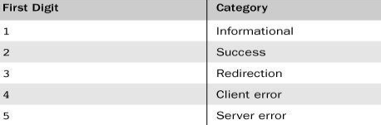
Unit 1 Web and HTML Fundamentals
Response Phase:
The general form of an HTTP response is as follows:
1. Status line
2. Response header fields
3. Blank line
4. Response body
For example, most responses begin with the following: HTTP/1.1 200 OK The status codes begin with 1, 2, 3, 4, or 5. The general meanings of the five categories specified by these first digits are shown

Slide 30
Unit 1 Web and HTML Fundamentals
Response Phase:
Response Headers have information about the server answering the request and the data being sent. Some are:
Server: The Server header tells the client about the server. It can include what type of operating system the server is running as well as the web server software that it is using.
Last-Modified: Last-Modified contains information about when the requested resource last changed. A static file that does not change will always transmit the same last modified timestamp associated with the file.
This allows cache mechanisms (like the Cache-Control request header) to decide whether to download a fresh copy of the file or use a locally cached copy.
Content-Length: Specifies how large the response body (message) will be. The requesting browser can then allocate an appropriate amount of memory to receive the data.
On dynamic websites where the Last-Modified header changes with each request, this field can also be used to determine the “freshness” of a cached copy.

Slide 31
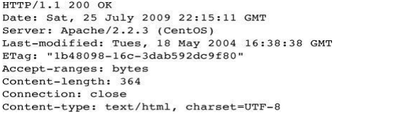
Unit 1 Web and HTML Fundamentals
Content-Type: Tells the browser what type of data is attached in the body of the message. Some media-type values are text/html, image/jpeg, image/png, application/xml, and others.
Content-Encoding: Even though a client may be able to gzip decompress files and specified so in the Accept-Encoding header, the server may or may not choose to encode the file. In any case, the server must specify to the client how the content was encoded so that it can be decompressed if need be.

Slide 32
Unit 1 Web and HTML Fundamentals
Content-Type: Tells the browser what type of data is attached in the body of the message. Some media-type values are text/html, image/jpeg, image/png, application/xml, and others.
Content-Encoding. Even though a client may be able to gzip decompress files and specified so in the Accept-Encoding header, the server may or may not choose to encode the file. In any case, the server must specify to the client how the content was encoded so that it can be decompressed if need be.
Response codes:
Response codes are integer values returned by the server as part of the response header.
These codes describe the state of the request, including whether it was successful, had errors, requires permission, and more.
For a complete listing, please refer to the HTTP specification. Some commonly encountered codes are listed in Table 2.1 to provide a taste of what kind of response codes exist. The codes use the first digit to indicate the category of response. 2## codes are for successful responses, 3## are for redirection-related responses, 4## codes are client errors, while 5## codes are server errors.

Slide 33
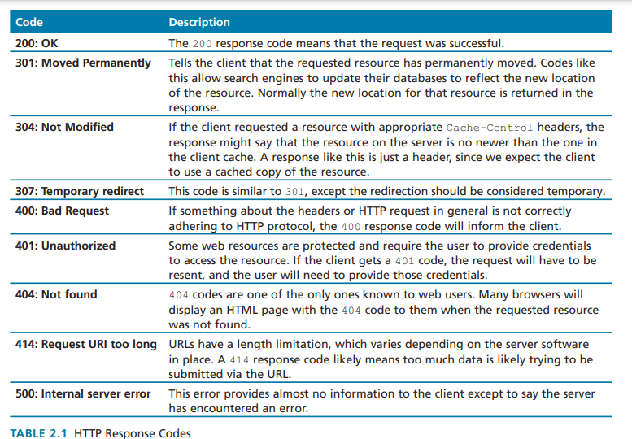
Unit 1 Web and HTML Fundamentals

Slide 34
Unit 1 Web and HTML Fundamentals
How the Web Works:
Request and Response Cycle: When you enter a URL in your browser, it sends a request to the web server hosting the site. The server processes this request and sends back the appropriate web page and resources (like images and stylesheets).
HTML, CSS, and JavaScript:
HTML: The backbone of web pages, providing structure and content. HTML uses tags to define elements like headings, paragraphs, links, and images.
CSS: Cascading Style Sheets are used to style and layout web pages. CSS controls visual aspects such as colors, fonts, and spacing.
JavaScript: A programming language that adds interactivity to web pages. JavaScript can create dynamic content, handle user events, and manipulate the DOM (Document Object Model).
Notes:
https://en.wikipedia.org/wiki/Internet
https://en.wikipedia.org/wiki/Hypertext
https://www.internetsociety.org/internet/historyinternet/briefhistoryinternet/
Relevance to Web and UX Development
Understanding the origins of the Internet provides context for the principles of web and UX development:
Protocol Evolution: Knowledge of protocols like TCP/IP helps in understanding how data is transmitted and how to optimize web performance.
Web Standards: Familiarity with HTML and CSS evolution aids in creating wellstructured and visually appealing websites.
User Experience Focus: The development of Web 2.0 and responsive design principles emphasizes the importance of creating intuitive, accessible, and engaging user experiences.

Slide 35
Unit 1 Web and HTML Fundamentals
Web development:
Web development is the building and maintenance of websites.
Web development is the process of developing websites or web applications that run on the Internet (or an Intranet). It can take various forms, including database management, web programming, and web design, among others. Web developers are responsible for executing these tasks and for maintenance, i.e., making sure that the website or app is wellbuilt and, more importantly, that it continues to function properly.
HTML, CSS, and JavaScript:
HTML: The backbone of web pages, providing structure and content. HTML uses tags to define elements like headings, paragraphs, links, and images.
Cascading Style Sheets (CSS) : Cascading Style Sheets are used to style and layout web pages. CSS controls visual aspects such as colors, fonts, and spacing.
JavaScript: A programming language that adds interactivity to web pages. JavaScript can create dynamic content, handle user events, and manipulate the DOM (Document Object Model).
Notes:
https://en.wikipedia.org/wiki/Internet
https://en.wikipedia.org/wiki/Hypertext
https://www.internetsociety.org/internet/historyinternet/briefhistoryinternet/
Relevance to Web and UX Development
Understanding the origins of the Internet provides context for the principles of web and UX development:
Protocol Evolution: Knowledge of protocols like TCP/IP helps in understanding how data is transmitted and how to optimize web performance.
Web Standards: Familiarity with HTML and CSS evolution aids in creating wellstructured and visually appealing websites.
User Experience Focus: The development of Web 2.0 and responsive design principles emphasizes the importance of creating intuitive, accessible, and engaging user experiences.

Slide 36
Unit 1 Web and HTML Fundamentals
Types of Web Development:
FrontEnd Development: Focuses on the userfacing aspects of a website. It involves HTML, CSS, and JavaScript to create visually appealing and interactive user interfaces.
BackEnd Development: Deals with serverside logic and databases. It ensures that data is processed correctly and interacts with the frontend. Common backend languages include Python, Ruby, PHP, and JavaScript (Node.js).
FullStack web development: Focus on both aspects.
UX (User Experience) Design: Involves designing websites and applications that are userfriendly and provide a positive experience. UX design includes understanding user needs, creating intuitive interfaces, and ensuring accessibility.
Responsive Design: Ensures that websites work well on a variety of devices, from desktops to smartphones. Responsive design uses flexible grids, layouts, and media queries to adapt content to different screen sizes.
Notes:
https://en.wikipedia.org/wiki/Internet
https://en.wikipedia.org/wiki/Hypertext
https://www.internetsociety.org/internet/historyinternet/briefhistoryinternet/
Relevance to Web and UX Development
Understanding the origins of the Internet provides context for the principles of web and UX development:
Protocol Evolution: Knowledge of protocols like TCP/IP helps in understanding how data is transmitted and how to optimize web performance.
Web Standards: Familiarity with HTML and CSS evolution aids in creating wellstructured and visually appealing websites.
User Experience Focus: The development of Web 2.0 and responsive design principles emphasizes the importance of creating intuitive, accessible, and engaging user experiences.
https://www.borngroup.com/

Slide 37
Unit 1 Web and HTML Fundamentals
Some Key Terminologies in Web Development:
Application Programming Interface (API): An API is a set of rules and protocols that helps programs communicate with each other to share information.
Frameworks: These are resources and tools for web developers to be able to build and maintain websites and web apps. These include AngularJS, React.js, and Vue.js.
Document Object Model (DOM): This is a type of language that is used for HTML or XML documents. This framework defines the structure of the documents and the way these documents are accessed or manipulated.
Bootstrap and jQuery: Bootstrap is used to create responsive and mobilefirst web pages, while jQuery is used to reduce the lines of code to achieve the same end goal.
Notes:
https://en.wikipedia.org/wiki/Internet
https://en.wikipedia.org/wiki/Hypertext
https://www.internetsociety.org/internet/historyinternet/briefhistoryinternet/
Relevance to Web and UX Development
Understanding the origins of the Internet provides context for the principles of web and UX development:
Protocol Evolution: Knowledge of protocols like TCP/IP helps in understanding how data is transmitted and how to optimize web performance.
Web Standards: Familiarity with HTML and CSS evolution aids in creating wellstructured and visually appealing websites.
User Experience Focus: The development of Web 2.0 and responsive design principles emphasizes the importance of creating intuitive, accessible, and engaging user experiences.
https://www.techopedia.com/definition/23889/webdevelopment

Slide 38
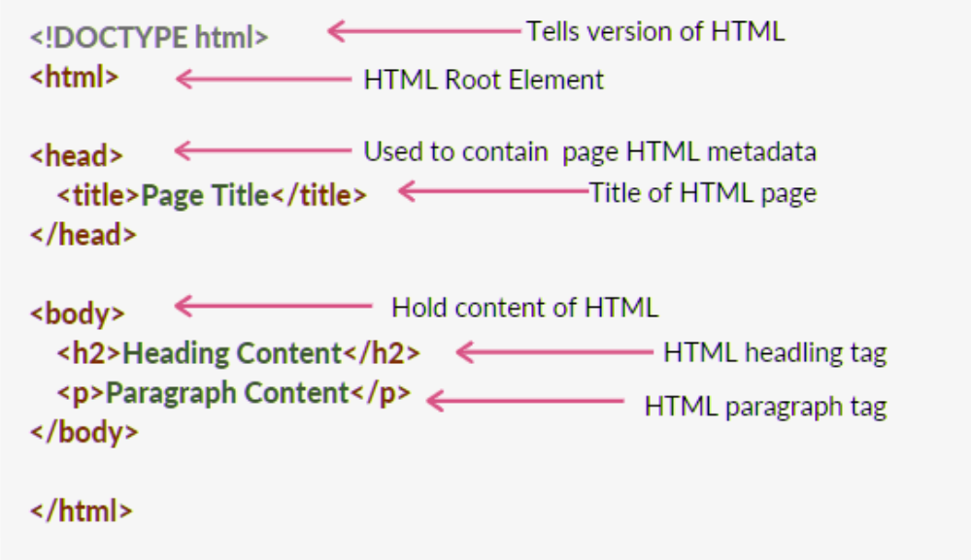
Unit 1 Web and HTML Fundamentals
Basic Structure of an HTML Document:
Notes:
https://en.wikipedia.org/wiki/Internet
https://en.wikipedia.org/wiki/Hypertext
https://www.internetsociety.org/internet/historyinternet/briefhistoryinternet/
Relevance to Web and UX Development
Understanding the origins of the Internet provides context for the principles of web and UX development:
Protocol Evolution: Knowledge of protocols like TCP/IP helps in understanding how data is transmitted and how to optimize web performance.
Web Standards: Familiarity with HTML and CSS evolution aids in creating wellstructured and visually appealing websites.
User Experience Focus: The development of Web 2.0 and responsive design principles emphasizes the importance of creating intuitive, accessible, and engaging user experiences.
https://www.techopedia.com/definition/23889/webdevelopment

Slide 39
Unit 1 Web and HTML Fundamentals
Some Essential HTML Tags
<!DOCTYPE html>: Declares the document type and version of HTML.
<html>: The root element of the HTML document.
<head>: Contains meta information about the document, such as character encoding, viewport settings, and links to stylesheets and scripts.
<body>: Contains the content of the document, such as headers, paragraphs, and links.
<header>, <nav>, <main>, <section>, <article>, <footer>: Semantic elements that define different parts of the page.
<title>: Sets the title of the document, shown in the browser's title bar or tab.
<link>: Links to external resources, like stylesheets.
<script>: Links to external JavaScript files or includes inline JavaScript.

Slide 40
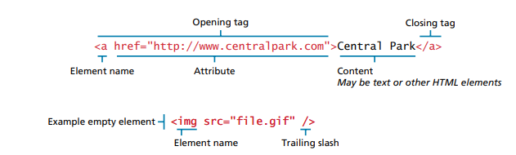
Unit 1 Web and HTML Fundamentals
The <h1> element defines a large heading
The <p> element defines a paragraph

Slide 41
Unit 1 Web and HTML Fundamentals
HTML Attributes:
HTML attributes provide additional information about HTML elements.
All HTML elements can have attributes
Attributes provide additional information about elements
Attributes are always specified in the start tag
Attributes usually come in name/value pairs like: name="value"
Example :
The <a> tag defines a hyperlink. The href attribute specifies the URL of the page the link goes to: <a href="https://www.w3schools.com">Visit W3Schools</a>
target - specifies where to open the linked document.

Slide 42
Unit 1 Web and HTML Fundamentals
HTML Attributes:
HTML attributes provide additional information about HTML elements.
All HTML elements can have attributes
Attributes provide additional information about elements
Attributes are always specified in the start tag
Attributes usually come in name/value pairs like: name="value"
Example :
The <a> tag defines a hyperlink. The href attribute specifies the URL of the page the link goes to: <a href="https://www.w3schools.com">Visit W3Schools</a>
target - specifies where to open the linked document.

Slide 43
Unit 1 Web and HTML Fundamentals
HTML Attributes:
<img> <img src="img_girl.jpg" width="500" height="600" alt="Girl with a jacket">
Style attribute - <tagname style="property:value;"> example - <p style="color:red;">This is a red paragraph.</p>
Some of the properties background-color, color (of text), font-family, font-size, text-align
<html lang="en"> The lang Attribute - to declare the language of the Web page. This is meant to assist search engines and browsers.
<html lang="en-US"> Country codes can also be added to the language code in the lang attribute.
title Attribute - <p title="I'm a tooltip">This is a paragraph.</p>

Slide 44
Unit 1 Web and HTML Fundamentals
HTML Attributes:
<img> <img src="img_girl.jpg" width="500" height="600" alt="Girl with a jacket">
Style attribute - <tagname style="property:value;"> example - <p style="color:red;">This is a red paragraph.</p>
Some of the properties background-color, color (of text), font-family, font-size, text-align
<html lang="en"> The lang Attribute - to declare the language of the Web page. This is meant to assist search engines and browsers.
<html lang="en-US"> Country codes can also be added to the language code in the lang attribute.
title Attribute - <p title="I'm a tooltip">This is a paragraph.</p>

Slide 45
Unit 1 Web and HTML Fundamentals
Using the <a> (anchor) tag:
Basic Syntax:
<a href="URL">Link Text</a>
href: The attribute that specifies the URL of the page the link goes to.
Link Text: The text that will appear as a clickable link.
Different use cases:
Link to another Webpage
<a href="https://www.example.com">Visit Example.com</a>
Link to a Different Section on the Same Page
<a href="#section1">Go to Section 1</a>
<!-- Later in the document -->
<h2 id="section1">Section 1</h2>

Slide 46
Unit 1 Web and HTML Fundamentals
Using the <a> (anchor) tag:
Basic Syntax:
<a href="URL">Link Text</a>
href: The attribute that specifies the URL of the page the link goes to.
Link Text: The text that will appear as a clickable link.
Different use cases:
Link to another Webpage
<a href="https://www.example.com">Visit Example.com</a>
Link to a Different Section on the Same Page
You’ll need an id on the target element:
<a href="#section1">Go to Section 1</a>
<!-- Later in the document -->
<h2 id="section1">Section 1</h2>

Slide 47
Unit 1 Web and HTML Fundamentals
3. Link to an Email Address
<a href="mailto:someone@example.com">Send an Email</a>
4. Link to a Phone Number
<a href="tel:+1234567890">Call Us</a>
5. Open Link in a New Tab
Use the target attribute with the value _blank:
<a href="https://www.example.com" target="_blank">Visit Example.com in a New Tab</a>

Slide 48
Unit 1 Web and HTML Fundamentals
HTML Lists
HTML lists allow web developers to group a set of related items in lists.
An unordered HTML list:
Item
Item
Item
Item
An ordered HTML list:
First item
Second item
Third item
Fourth item

Slide 49
Unit 1 Web and HTML Fundamentals
HTML Lists
HTML lists allow web developers to group a set of related items in lists.
An unordered HTML list:
Item
Item
Item
Item
An ordered HTML list:
First item
Second item
Third item
Fourth item

Slide 50
Unit 1 Web and HTML Fundamentals
Unordered HTML List
An unordered list starts with the <ul> tag. Each list item starts with the <li> tag.
The list items will be marked with bullets (small black circles) by default:
Example:
<ul>
<li>Coffee</li>
<li>Tea</li>
<li>Milk</li>
</ul>

Slide 51
Unit 1 Web and HTML Fundamentals
Ordered HTML List
An ordered list starts with the <ol> tag. Each list item starts with the <li> tag.
The list items will be marked with numbers by default:
Example
<ol>
<li>Coffee</li>
<li>Tea</li>
<li>Milk</li>
</ol>

Slide 52
Unit 1 Web and HTML Fundamentals
HTML Description Lists
HTML also supports description lists. A description list is a list of terms, with a description of each term. The <dl> tag defines the description list, the <dt> tag defines the term (name), and the <dd> tag describes each term:
Example
<dl>
<dt>Coffee</dt>
<dd>- black hot drink</dd>
<dt>Milk</dt>
<dd>- white cold drink</dd>
</dl>

Slide 53
Unit 1 Web and HTML Fundamentals
HTML Description Lists
HTML also supports description lists. A description list is a list of terms, with a description of each term. The <dl> tag defines the description list, the <dt> tag defines the term (name), and the <dd> tag describes each term:
Example
<dl>
<dt>Coffee</dt>
<dd>- black hot drink</dd>
<dt>Milk</dt>
<dd>- white cold drink</dd>
</dl>

Slide 54
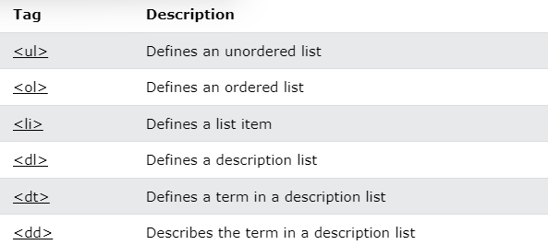
Unit 1 Web and HTML Fundamentals
HTML List Tags

Slide 55
Unit 1 Web and HTML Fundamentals
HTML List Tags

Slide 56
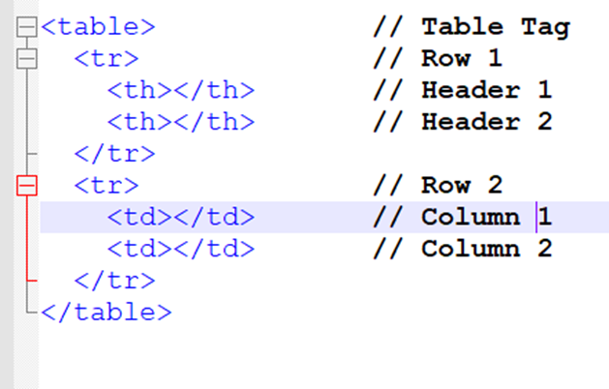
Unit 1 Web and HTML Fundamentals
HTML Tables:
HTML tables allow web developers to arrange data into rows and columns.

Slide 57
Unit 1 Web and HTML Fundamentals
HTML Table:
Each Table Cell is defined by a <td> and a </td> tag. td stands for table data. Everything between <td> and </td> are the content of the table cell.
Note: A table cell can contain all sorts of HTML elements: text, images, lists, links, other tables, etc.
Table Rows : Each table row starts with a <tr> and ends with a </tr> tag.
tr stands for table row.
Table Headers
Sometimes you want your cells to be table header cells. In those cases use the <th> tag instead of the <td> tag:
th stands for table header. By default, the text in <th> elements are bold and centered, but you can change that with CSS.

Slide 58
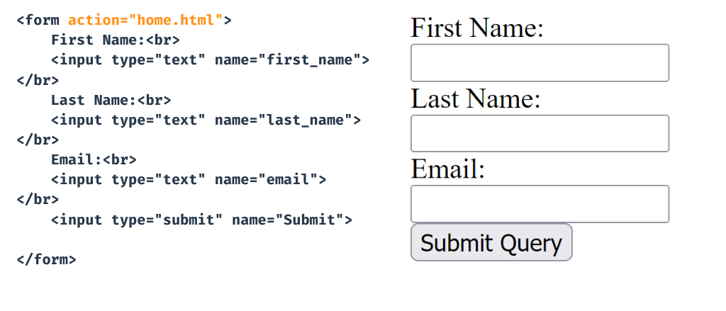
Unit 1 Web and HTML Fundamentals
HTML Forms
An HTML form is used to collect user input. The user input is most often sent to a server for processing.

Slide 59
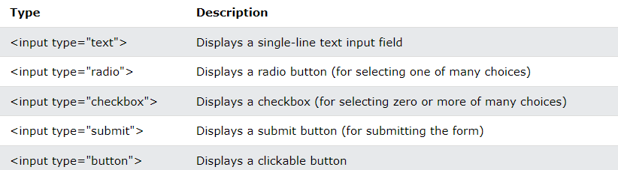
Unit 1 Web and HTML Fundamentals
The <form> element is a container for different types of input elements, such as: text fields, checkboxes, radio buttons, submit buttons, etc.
The HTML <input> element is the most used form element. An <input> element can be displayed in many ways, depending on the type attribute.

Slide 60
Unit 1 Web and HTML Fundamentals
The <form> element is a container for different types of input elements, such as: text fields, checkboxes, radio buttons, submit buttons, etc.
The HTML <input> element is the most used form element. An <input> element can be displayed in many ways, depending on the type attribute.

Slide 61
Unit 1 Web and HTML Fundamentals
The <label> tag defines a label for many form elements. The <label> element is useful for screen-reader users, because the screen-reader will read out loud the label when the user focuses on the input element.
The <label> element also helps users who have difficulty clicking on very small regions (such as radio buttons or checkboxes) - because when the user clicks the text within the <label> element, it toggles the radio button/checkbox. The for attribute of the <label> tag should be equal to the id attribute of the <input> element to bind them together.
The <input type="radio"> defines a radio button. Radio buttons let a user select ONE of a limited number of choices.
The <input type="checkbox"> defines a checkbox. Checkboxes let a user select ZERO or MORE options of a limited number of choices.
The <input type="submit"> defines a button for submitting the form data to a form-handler. The form-handler is typically a file on the server with a script for processing input data. The form-handler is specified in the form's action attribute.
The Name Attribute for <input>
Notice that each input field must have a name attribute to be submitted. If the name attribute is omitted, the value of the input field will not be sent at all.

Slide 62
